Slide 1
Super-Resolution of Images
Prepared by
Iftekhar Hakim Kaowsar (1705045)
Apurba Saha (1705056)
Maisha Rahman Mim (1705060)

Slide 2
Problem Definition
Problem Definition: The task is to train a model that can increase the resolution of an image, using a set of high-resolution images.

Slide 3
Dataset
Dataset :https://data.vision.ee.ethz.ch/cvl/DIV2K/
900 High resolution images.
100 images were subsampled for training.
5 images for validation.

Slide 4
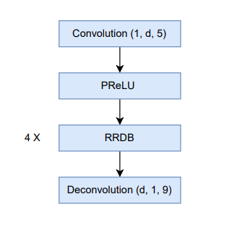
Architecture
Main flow

Slide 5
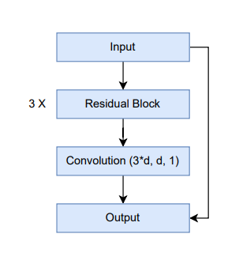
Architecture
Residual in Residual Dense Block (RRDB)

Slide 6
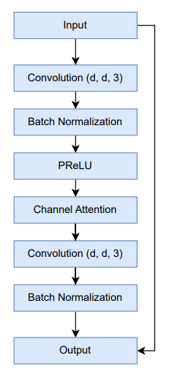
Architecture
Residual Block

Slide 7
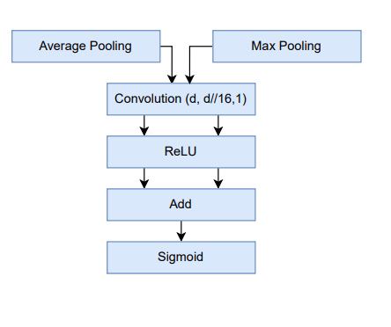
Architecture
Channel Attention

Slide 8
Loss Function
Mean Squared Error (MSE)
Average of the squared differences between the predicted
output and the target image, pixel-wise.
Well-defined gradient, which makes it easier to optimize models using gradient descent.
Loss in our model: 0.001469

Slide 9
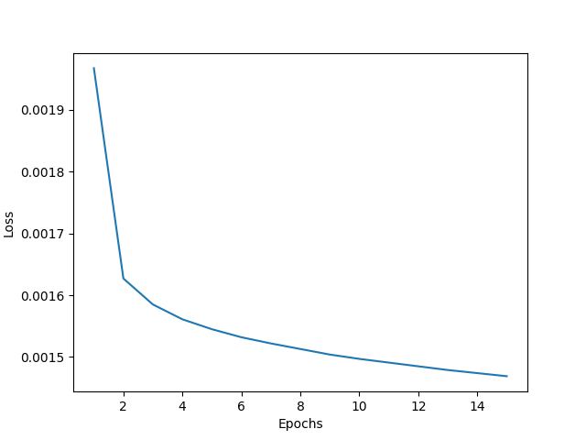
Loss Function (cont.)

Slide 10
Performance Report
Metric: PSNR
This ratio is used as a quality measurement between the original and a generated image.
PSNR in our model: 33.78

Slide 11

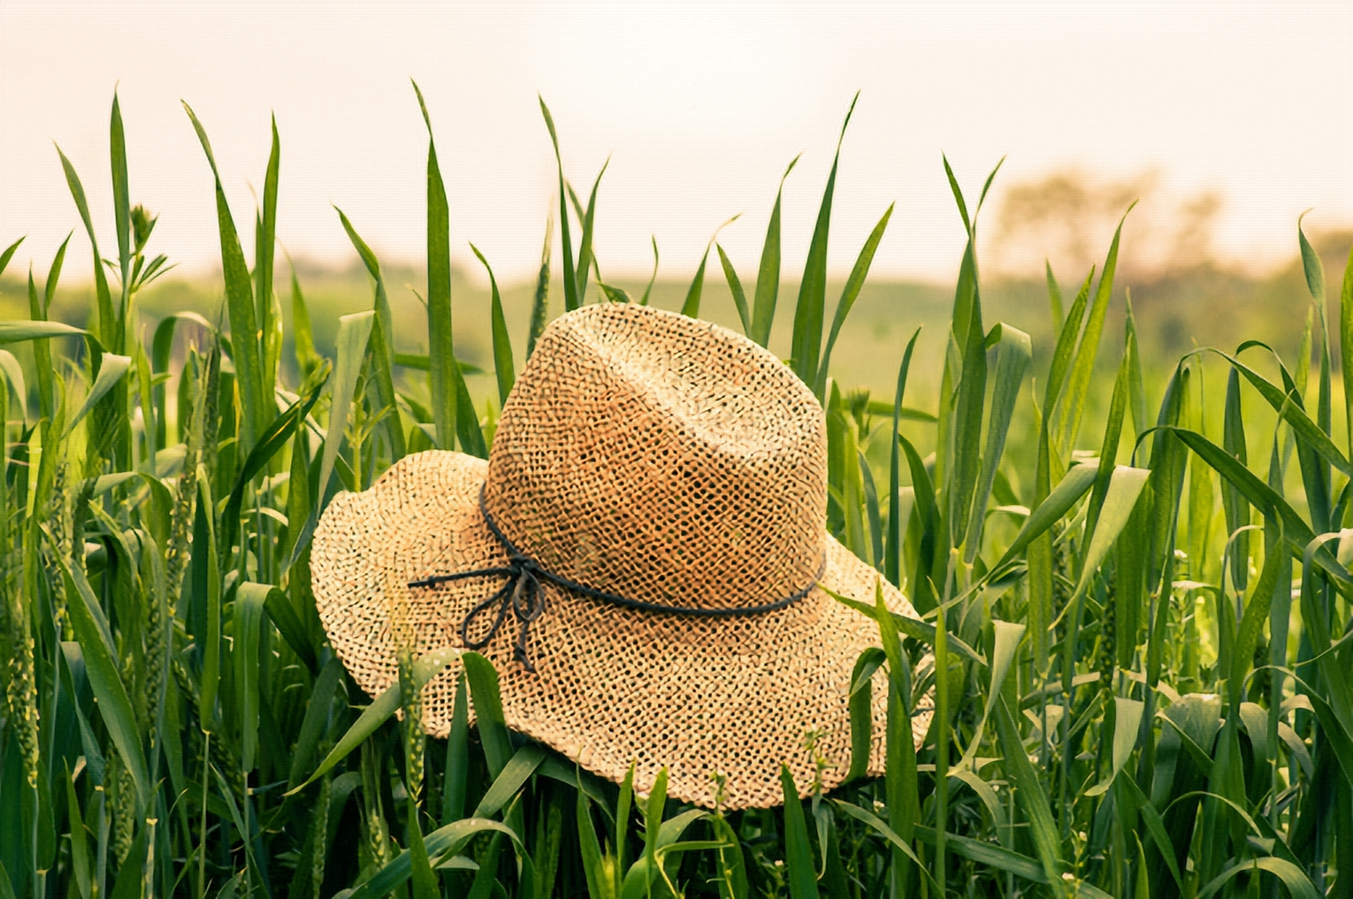
Performance Report (cont.)
Input Image
Output Image

Slide 12
Comparison with FSRCNN
PSNR of paper: 33.06 (ours was 33.78)

Slide 13
Challenges
Training with these much images without GPU.
Working with large number of residual groups and blocks was problematic, as it takes too much time and RAM.
Setting up old code of the paper was tough, as their environment was too old.

Slide 14
Related Papers
Accelerating the Super-Resolution Convolutional Neural Network
Image Super-Resolution Using Very Deep Residual Channel Attention Networks
ESRGAN: Enhanced Super-Resolution Generative Adversarial Networks

Slide 15
THANK YOU

